Slide 1
Linear modelling theory
With multiple explanatory variables

Slide 2
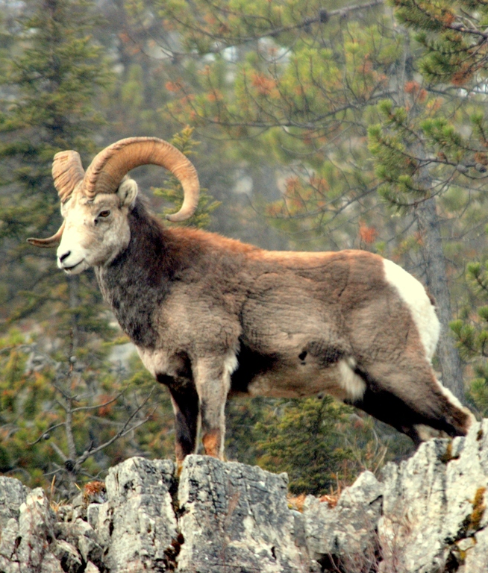
Complexity of the real world
Pine
marten
Tawny
owl
Horn
length
Region
So far we’ve considered single explanatory variables
Continuous and Categorical
Is this enough to understand the world?

Slide 3
Complexity of the real world
Mother’s
condition
Food
availability
Genetics
Horn
length
Region
Cohort
Predation
Competition
Age at
death

Slide 4

Complexity of the real world
Mother’s
condition
Food
availability
Genetics
Horn
length
Region
Cohort
Predation
Competition
Age at
death
$$y_{i}∼Normal\left(μ_{i}, σ\right) \\ μ_{i}=β_{0}+β_{1}×Skeena_{i}$$

Slide 5

How do we capture the Data Generating Process?
All other influences are still happening, regardless if they’re in the model or not
If we don’t include these, they get lumped into $σ$ (i.e. unexplained variation)
  $Normal\left(μ_{i}, σ\right)$
How do we include more variables so that we can get a deeper understand of the system?
Mother’s
condition
Food
availability
Genetics
Horn
length
Region
Cohort
Predation
Competition
Age at
death

Slide 6
Multiple variables in R
Adding multiple variables in R is trivial
We literally just add them to the linear model code
We do all of our usual steps:
  Start with a question
  Identify any hidden assumptions
  Carry out data exploration
  Run the model
  Diagnose the model
    Same requirements as before
  Plot the results
shp_mod <- lm(horn ~ region +
cohort +
age_death +
food,
data = shp_dat)

Slide 7
The question

Slide 8
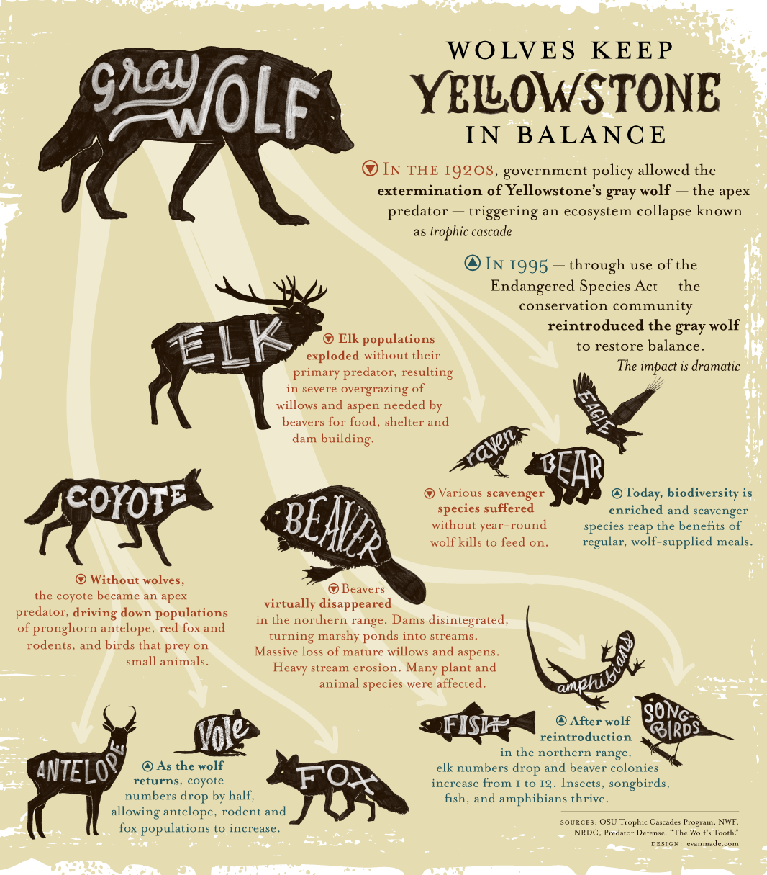
Trophic cascades
Includes lots of hugely popular ecology theories, especially amongst public
  “Food webs”
  “Landscape of fear”
  “Keystone species”
  “Ecosystem balance”
Lots of papers found evidence for trophic cascades, e.g. Beyer et al (2007)
But has been heavily critiqued

Slide 9
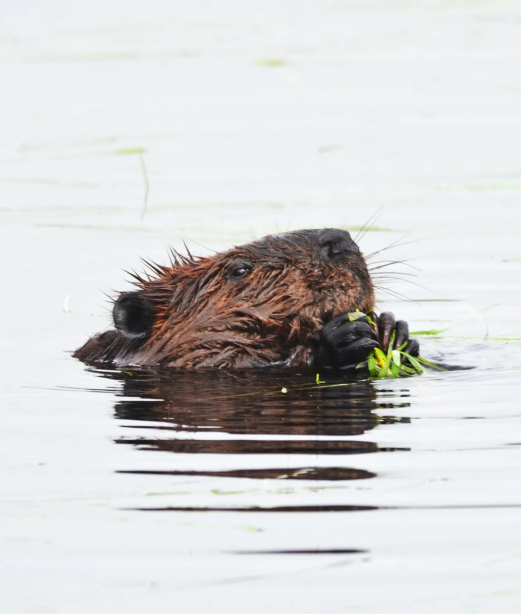



The question
We want to see if wolf presence has a positive relationship with beaver density.
How would you use the tools you have learnt to find evidence of a trophic cascade?
$$B_{i}∼Normal\left(μ_{i}, σ\right) \\ μ_{i}=β_{0}+β_{1}×W_{i}$$
$W$olf
presence
$B$eaver
density

Slide 10
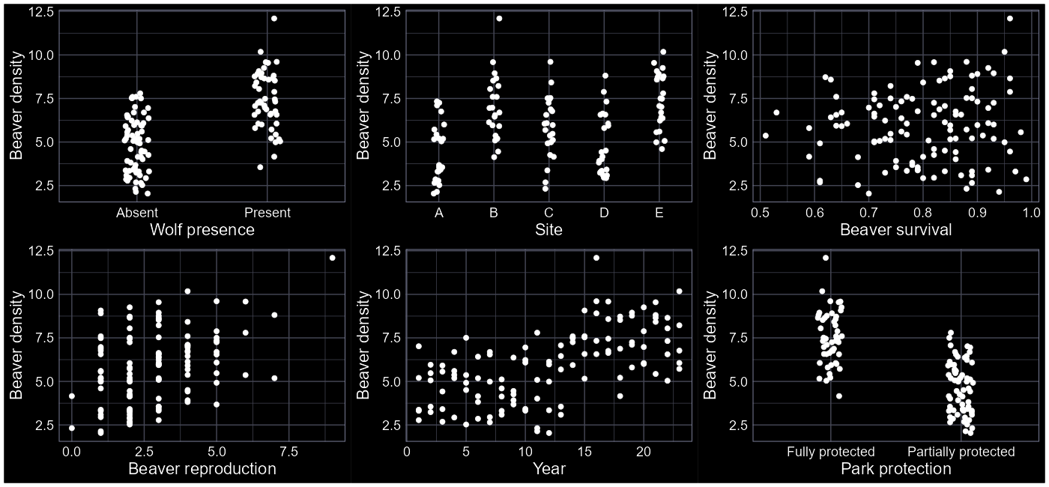

Slide 11
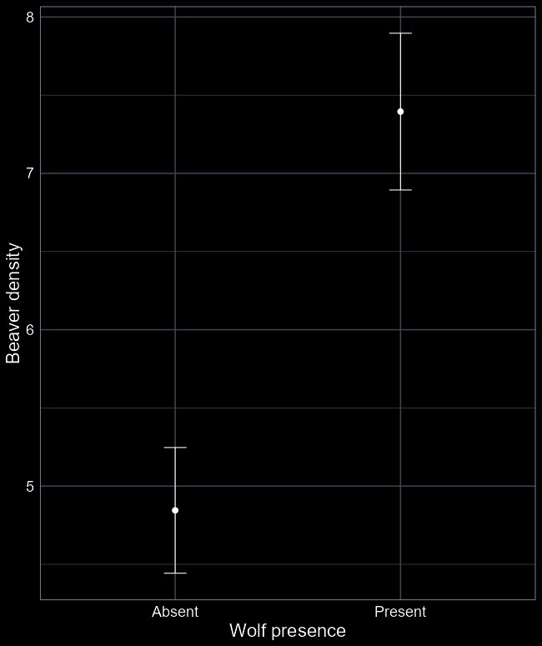
Test hypothesis with lm()
Start with simple model:
  lm(beaver ~ wolf)
wolf is categorical (Present or Absent)
Same type of model as in last week, so we’ll skip to the results
Do wolves increase beaver density?
Is the system really that simple?
Singular causes and effects are incredibly rare in the real world.

Slide 12




Complex worlds
Misinformation often created by attributing singular causes to complex phenomena
Common in:
  Clickbait
  Political statements
  Health products
  Advertising
  Scientific communication

Slide 13
Incorporate complexity
Wolves won’t be the only thing influencing beaver density
Surely the probability survival to survive from one year to the next will influence beaver density?
How do we include survival?
Wolf
presence
Beaver
density
Beaver
survival

Slide 14
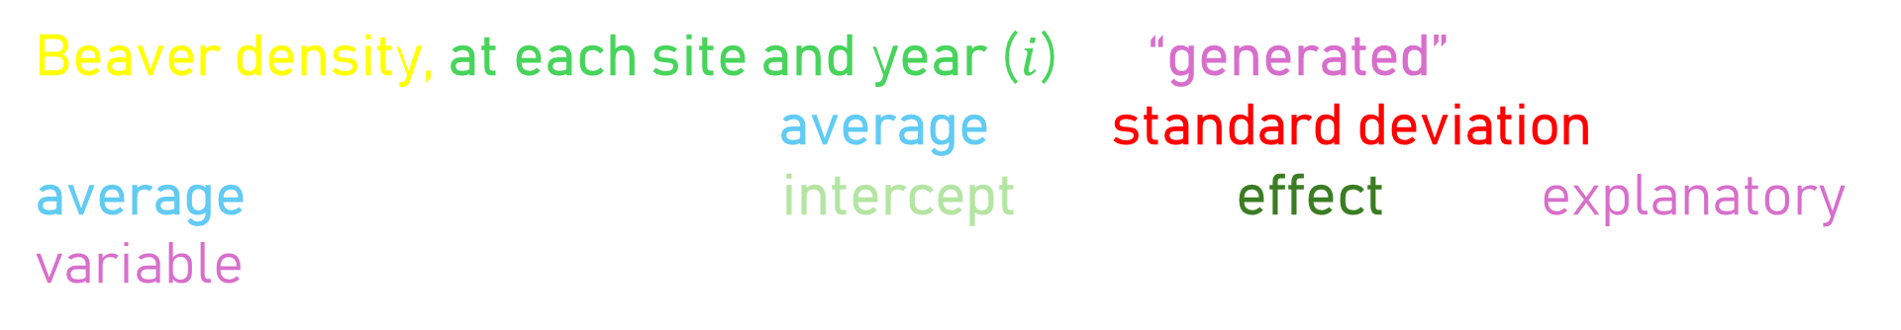
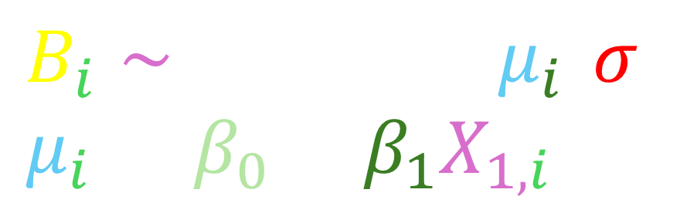
$$B_{i}∼Normal\left(μ_{i}, σ\right) \\ μ_{i}=β_{0}+β_{1}X_{1,i}$$
Beaver density, at each site and year ($i$), is “generated” according to a $Normal$ distribution, with an average and standard deviation. The average is determined by an intercept and the effect of an explanatory variable (called $X_{1}$ here)

Slide 15



$$B_{i}∼Normal\left(μ_{i}, σ\right) \\ μ_{i}=β_{0}+β_{1}X_{1,i}$$
$$+ β_{2}X_{2,i}$$
Beaver density, at each site and year ($i$), is “generated” according to a $Normal$ distribution, with an average and standard deviation. The average is determined by an intercept and the effect of an explanatory variable (called $X_{1}$ here)
To add more explanatory variables, we simply add them in

Slide 16


Including additional explanatory variables
$$B_{i}∼Normal\left(μ_{i}, σ\right) \\ μ_{i}=β_{0}+β_{1}W_{i}$$
$$+β_{2}S_{i}$$
Wolf
presence
Beaver
density
Beaver
survival
This equation will create two lines; one for beaver survival when wolves are present ($W=1$), and another for beaver survival when wolves are absent ($W=0$)

Slide 17
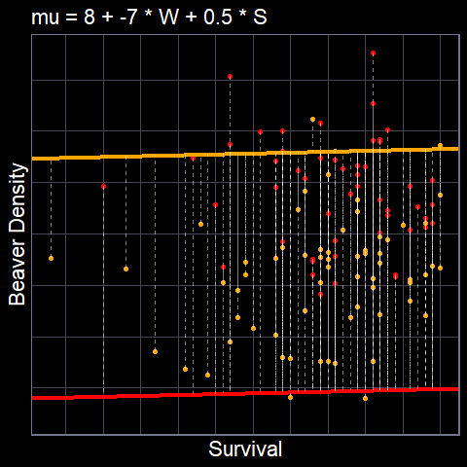
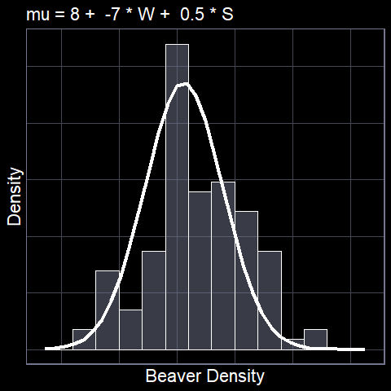

$$μ_{i}=β_{0}+β_{1}W_{i}+β_{2}S_{i}$$

Slide 18
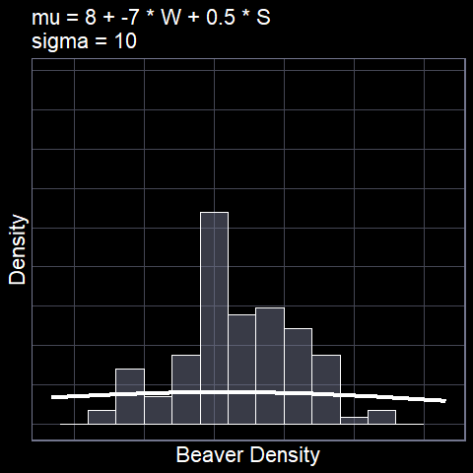

$$B_{i}∼Normal\left(μ_{i}, σ\right) \\ μ_{i}=β_{0}+β_{1}W_{i}+β_{2}S_{i}$$

Slide 19
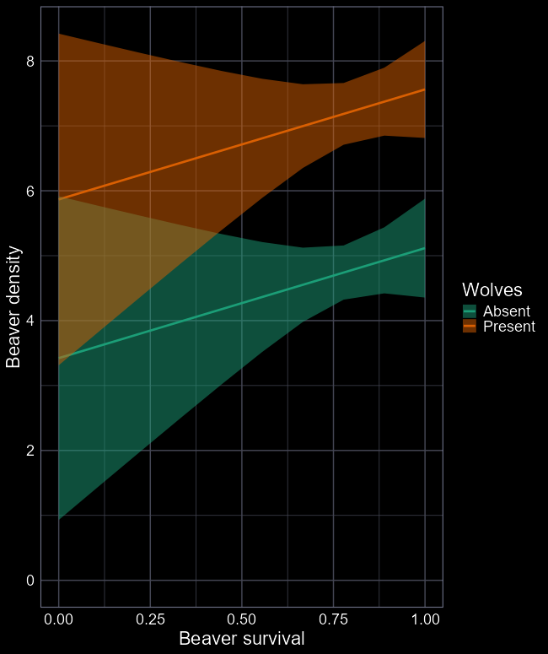





What do our parameters mean?
$μ_{i}=β_{0}+β_{1}W_{i}+β_{2}S_{i}$
  $β_{0}$ is the average number of beavers when $W$ is $0$ and $S$ is $0$
    So when wolves are Absent and survival is 0 %
  $β_{1}$ is difference in the number of beavers when $W$ is $1$ and $S$ is $0$
    When wolves are Present and survival is 0 %
  $β_{2}$ is the slope for $S$
    How many extra beavers there are when $S$ increases by 1 (here 0 is 0% and 1 is 100%)
$$β_{2}$$
$$β_{1}$$
$$β_{2}$$
$$β_{0}$$

Slide 20
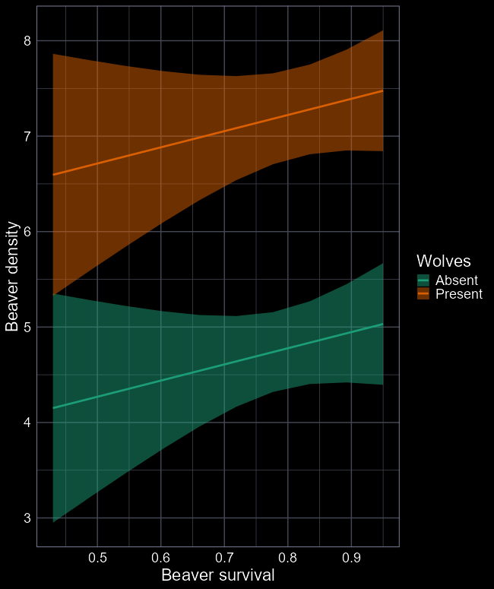

Test trophic cascade with lm()
Go through the usual steps (not shown)
$μ_{i}=β_{0}+β_{1}W_{i}+β_{2}S_{i}$
  $β_{0}=3.4$
  $β_{1}=2.4$
  $β_{2}=1.7$
Do wolves increase beaver density?
How strong is the evidence for a trophic cascade?

Slide 21

Predicting
$μ_{i}=β_{0}+β_{1}W_{i}+β_{2}S_{i}$
  $β_{0}=3.4$
  $β_{1}=2.4$
  $β_{2}=1.7$
How many beavers if:
  Wolves are absent and survival is 0?
    $3.4+2.4×0+1.7×0=3.40$
  Wolves are absent and survival is 0.5?
    $3.4+2.4×0+1.7×0.5=4.25$
  Wolves are present and survival is 0?
    $3.4+2.4×1+1.7×0=5.80$
  Wolves are present and survival is 0.7?
    $3.4+2.4×1+1.7×0.7=6.99$

Slide 22

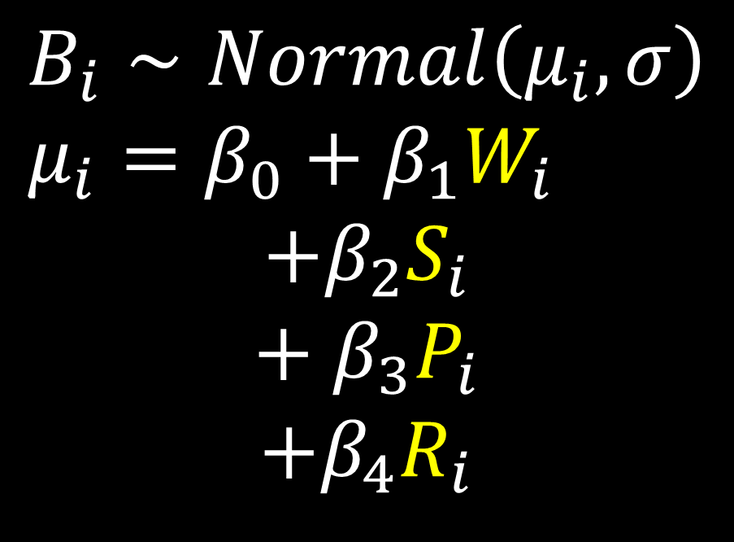



Including even more variables
$P$ark
protection
$$B_{i}∼Normal\left(μ_{i}, σ\right) \\ μ_{i}=β_{0}+β_{1}W_{i}$$
$$+β_{2}S_{i}$$
$$+ β_{3}P_{i}$$
$$+β_{4}R_{i}$$
$W$olf
presence
Beaver
density
Beaver
$S$urvival
Beaver
$R$eproduction

Slide 23
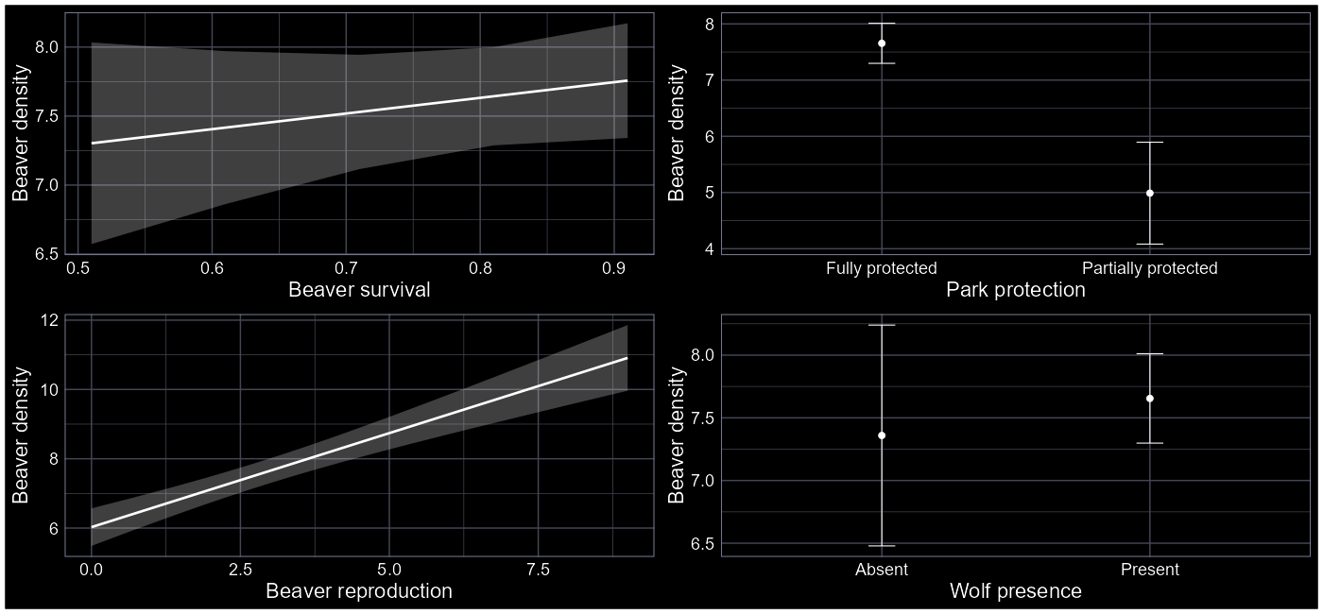
What do we learn from the new model?

Slide 24
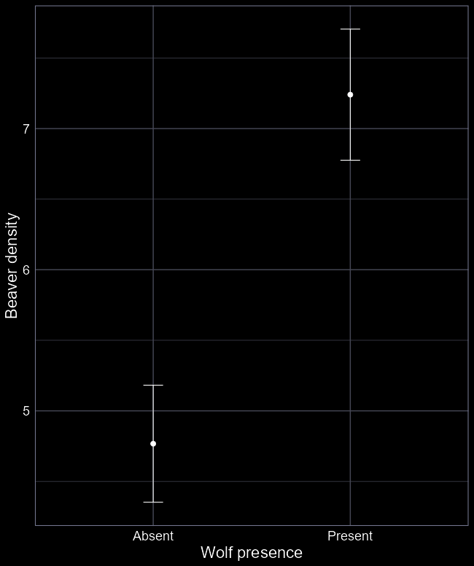
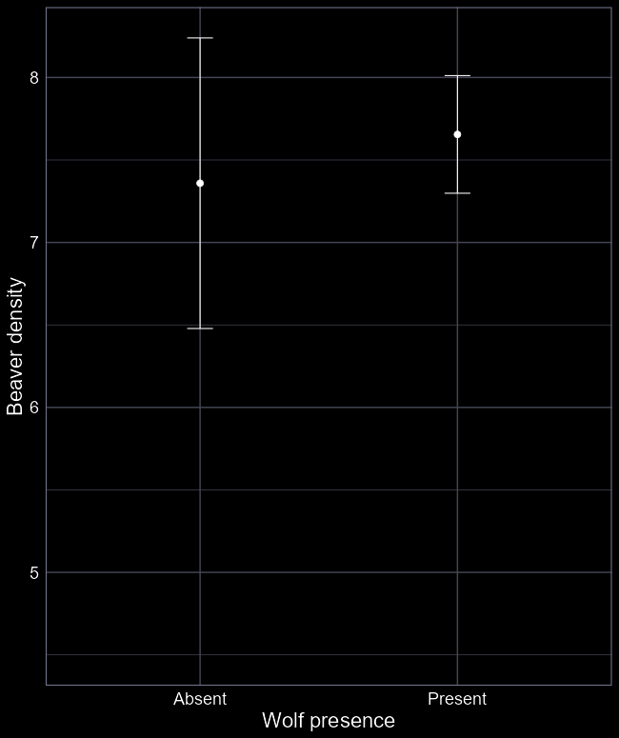


What happened to our trophic cascade?
$$μ_{i}=β_{0}+β_{1}W_{i}$$
$$μ_{i}=β_{0}+β_{1}W_{i}+ \\ β_{2}S_{i}+ β_{3}P_{i}+β_{4}R_{i}$$

Slide 25




Our representation of the system was wrong
$W$olf
presence
$P$ark
protection
What we originally assumed
But this was wrong
I only know it’s wrong because I simulated this data
Wolves never influenced beaver density
But both beavers and wolves benefitted from Yellowstone being fully protected
Wolves and beavers are confounded by park protection!
$P$ark
protection
$W$olf
presence
Beaver
$S$urvival
Beaver
density
Beaver
density
Beaver
$S$urvival
Beaver
$R$eproduction
Beaver
$R$eproduction

Slide 26
What happened to our trophic cascade?
Confounded
and incorrect:
Trophic cascade
Unconfounded
and correct:
No trophic cascade
$$μ_{i}=β_{0}+β_{1}W_{i}$$
$$μ_{i}=β_{0}+β_{1}W_{i}+ \\ β_{2}S_{i}+ β_{3}P_{i}+β_{4}R_{i}$$

Slide 27

Confounding
Confounding is a huge problem in science
Big cause of scientists producing misinformation
  Without knowing they are
Often reason for exciting results
  Which get published in big journals
In the next lecture, we will talk more about confounding

Slide 28
tl;dr
We always start with a question
Statistics is merely how we answer the question
Start by plotting your data – get a feel for what’s going on
  Also really useful to draw your data generating process
Run your model, including variables you think are appropriate
  Appreciate the underlying theory
Interpret what those parameter values mean biologically
Be cautious of confounding (more in next lecture)
  Be aware, running a model with only one variable does not protect you against confounding nor does running one with multiple variables
See here: https://www.nps.gov/articles/the-big-scientific-debate-trophic-cascades.htm for discussion of Yellowstone results

